Slide 1

ANZ synthesized transaction (Task 1)
By: Atefeh Gholipour

Slide 2
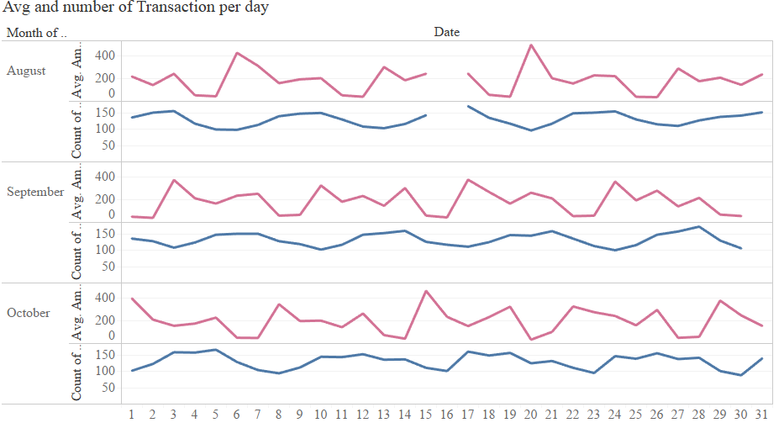
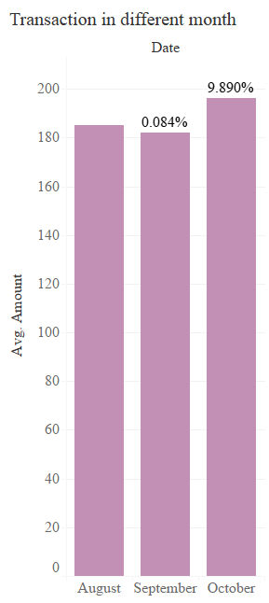
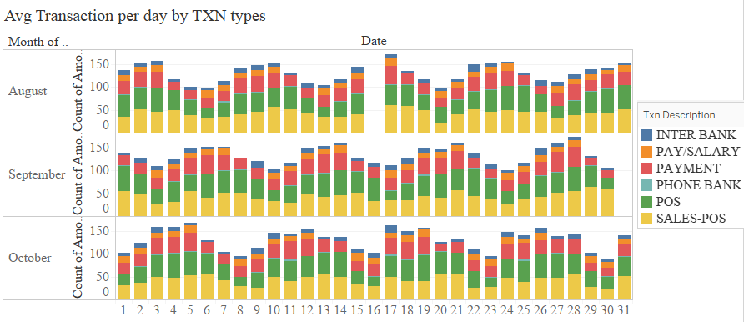
Number and Average of Transactions
Same trend for number of transactions per month
No data is available for 16th August
The average amount of transaction is almost same for three months.

Slide 3
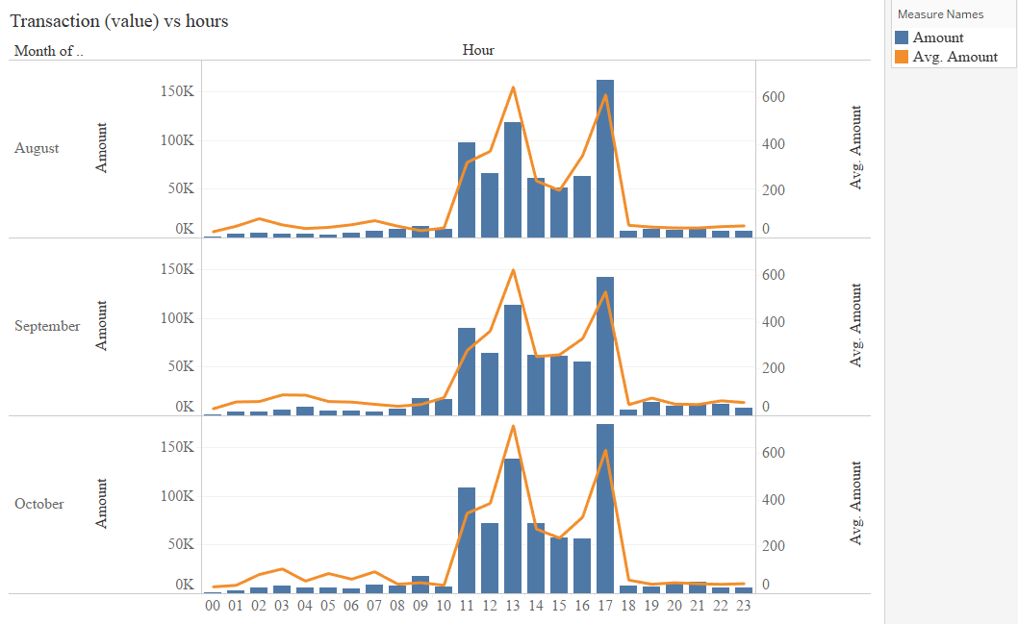
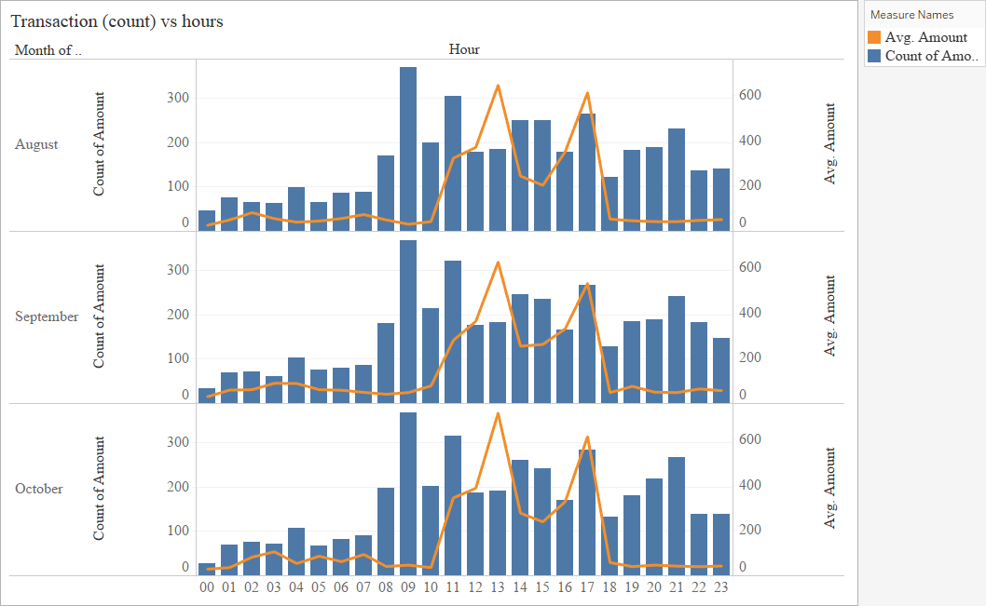
Trend in Different Hours of a Day
Most high-value transactions are performed during opening hours of the bank.
Same trend for every month.

Slide 4
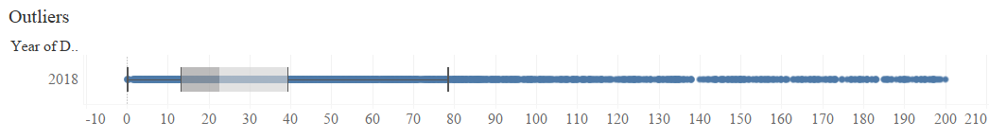
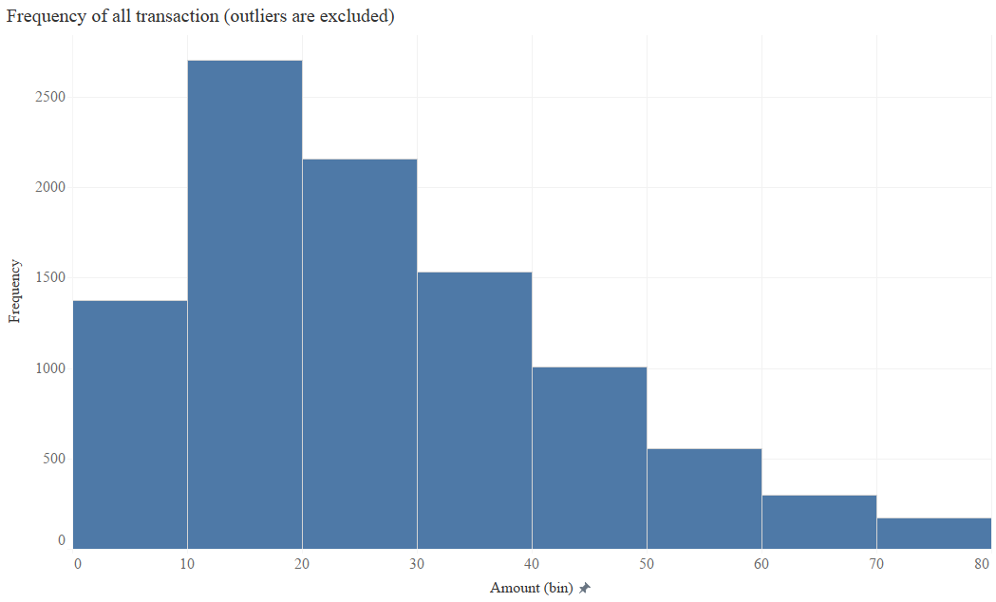
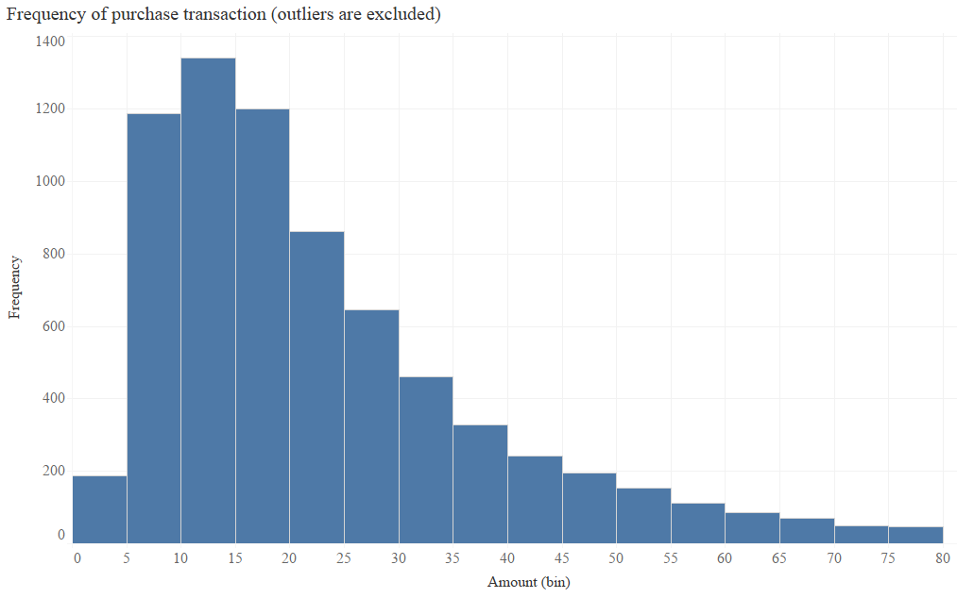
Frequency of Transaction Amount
Using box plot outliers are found.
The frequency of purchase and all transaction after excluding outliers are shown.

Slide 5
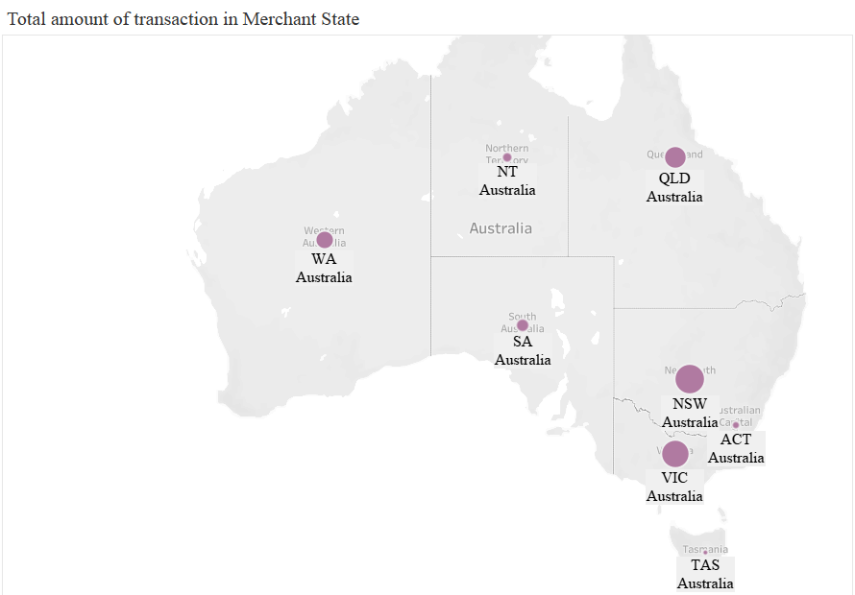
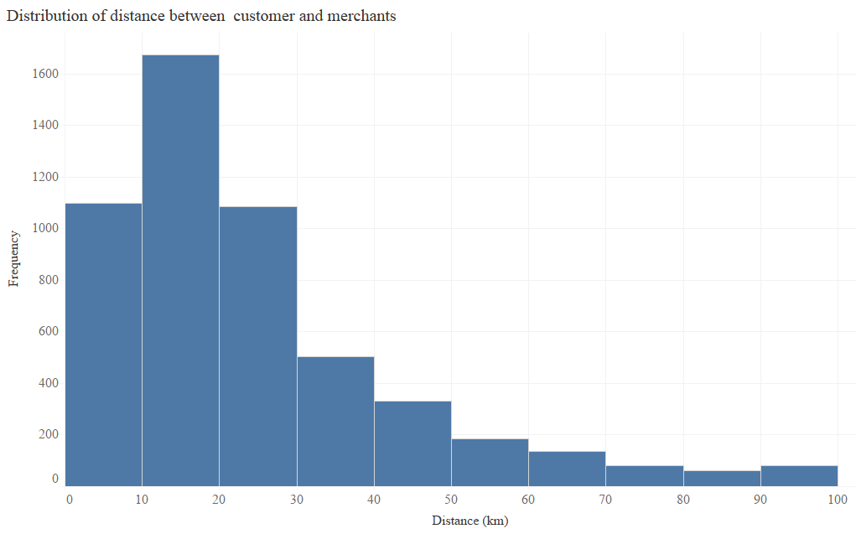
Exploring Location Information
NSW and Victoria are the most contributor

Slide 6
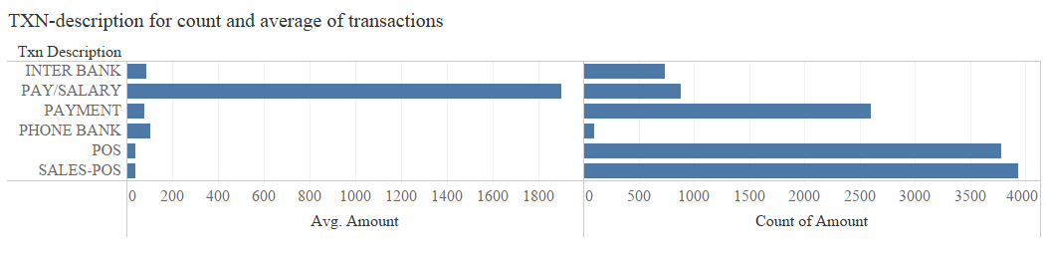
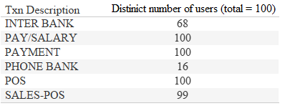
Transaction types
Pay/Salary has the most contribution in transactions based on value, 100% of customers use this bank as their salary account.
POS and SALES-POS has the small amount of transaction with high volume which can determine the load on system.

Slide 7
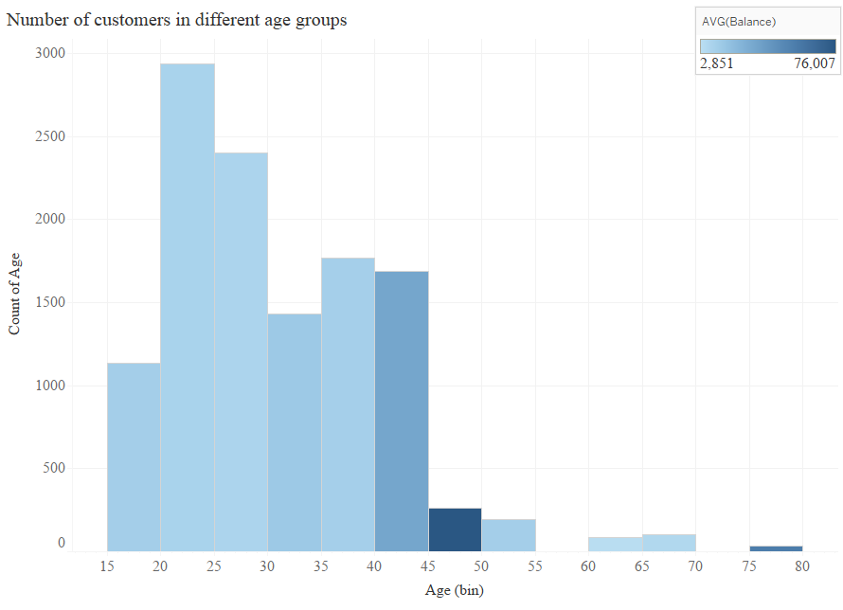
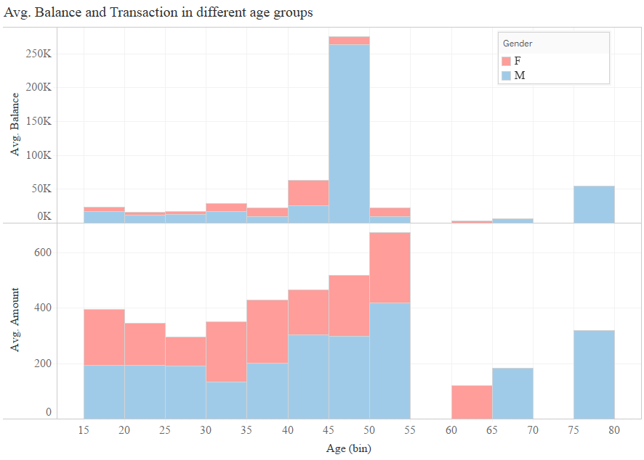
Demographic variables
Customers in 45-50 and 75-80 age groups have the higher balance.
Most customers of the bank are young and middle-aged groups.
Both gender have almost the same transaction.
Men have higher balance.

Slide 8
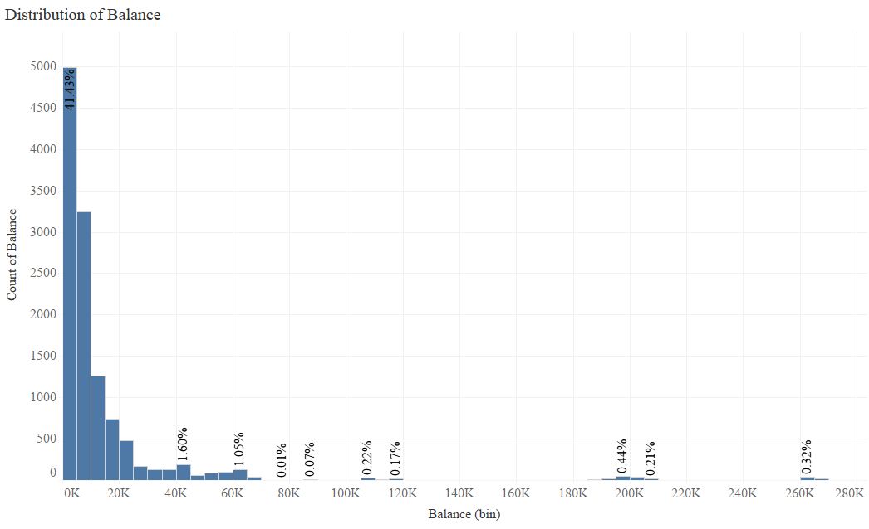
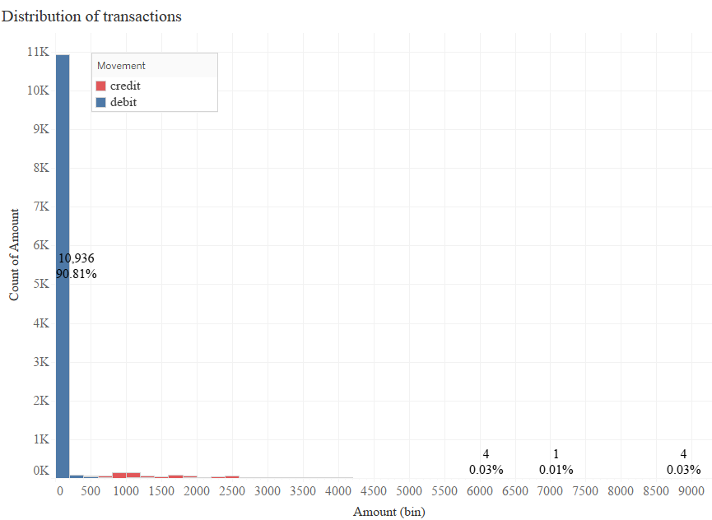
Distribution of Balance and Transactions
90% of transactions are below $200
Customers use their debit cards for transactions below $400 and credit cards for higher value.
Almost 85% of customers have balance less than $10,000

